Slide 1
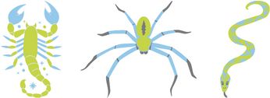
Custom Peptides
as Membrane Active Peptides
From venoms to drugs
VenomScreen
Toxin Catalog
Peptide Synthesis
contact@smartox-biotech.com
www.smartox-biotech.com

